Slide 1
SSWD – Project Presentation
Kiddie Clubhouse
Aleksandar Mladenov, James Walsh, Robert Tracey

Slide 2
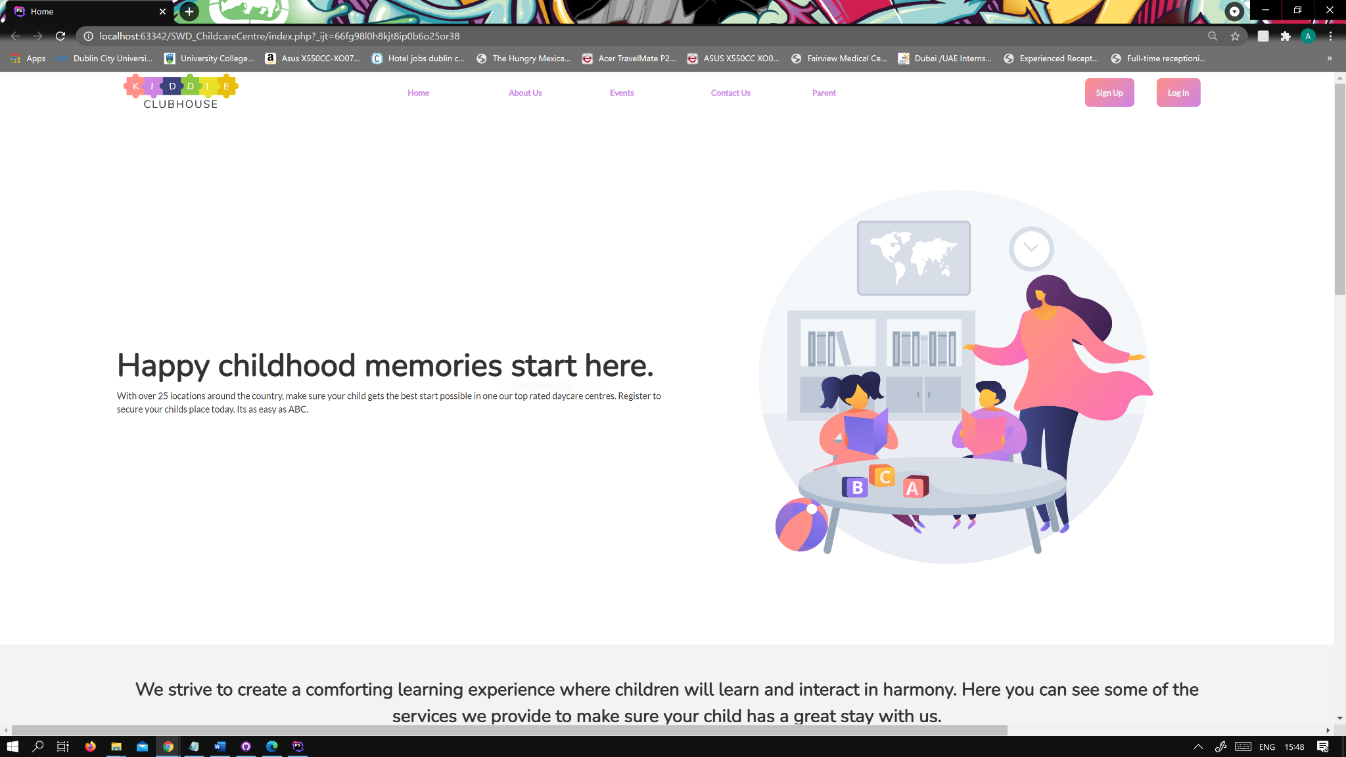
Visual Design
Landing page – screenshot
Rounded sans-serif font
Modern aesthetics with neutral
background colours.
Bright colour palette used to
to compliment neutral backgrounds.
Primary & Secondary colours used
to make gradients for buttons.

Slide 3
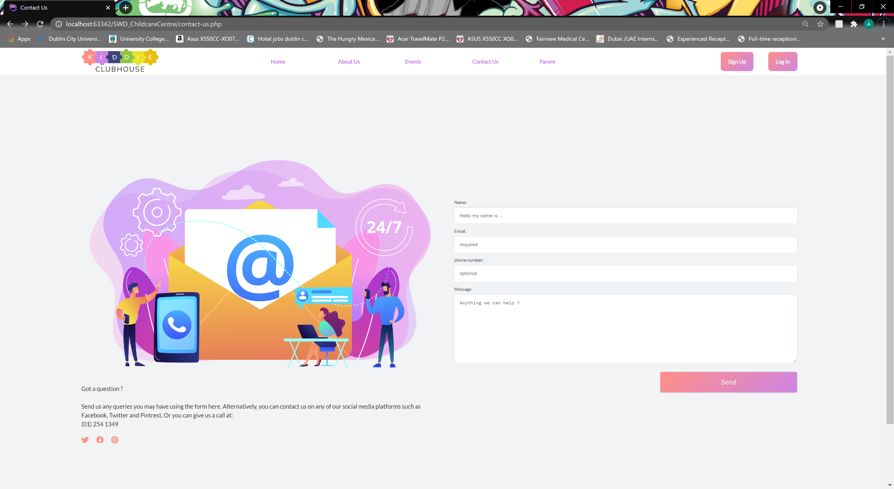
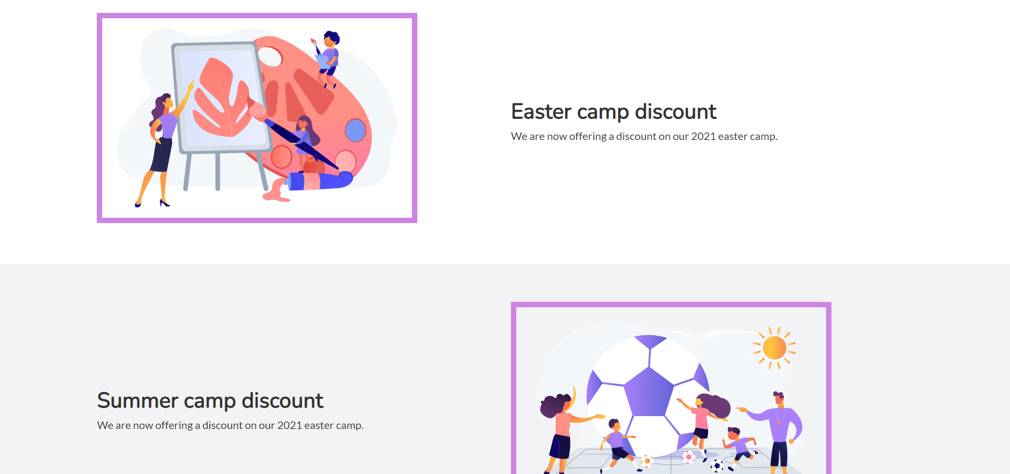
Visual Design
All pages used a grid system for a
clean minimal layout style and to
make all pages uniform.
Neutral background colours with primary
and secondary colours used for
highlighting.

Slide 4
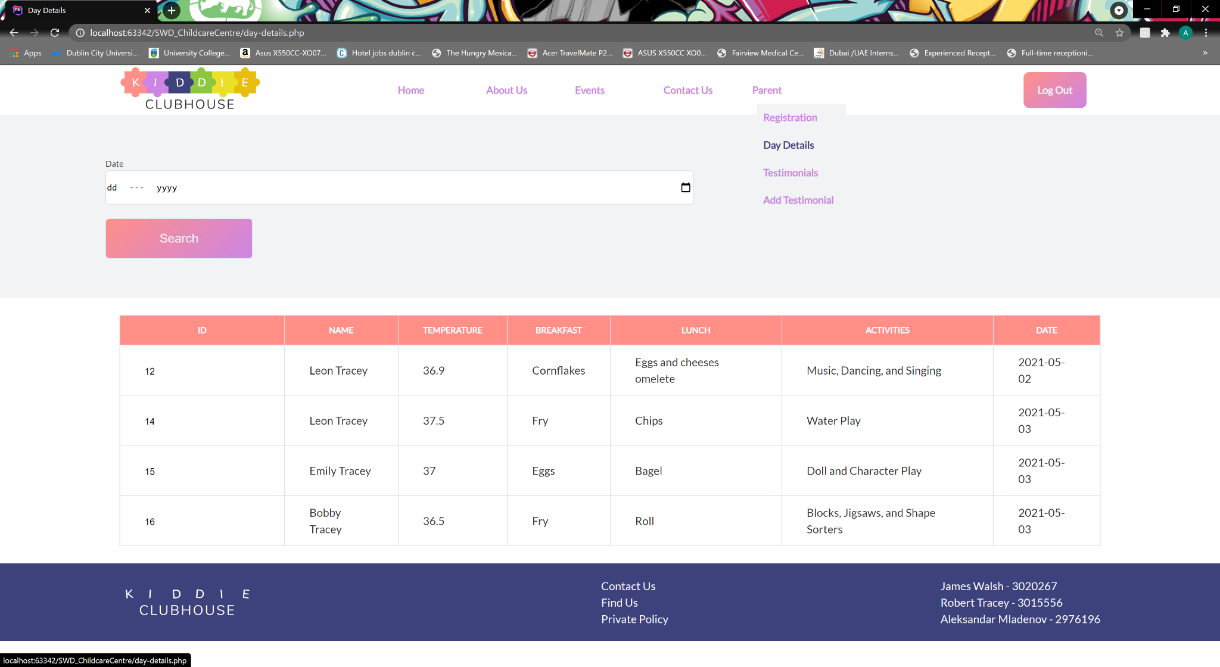
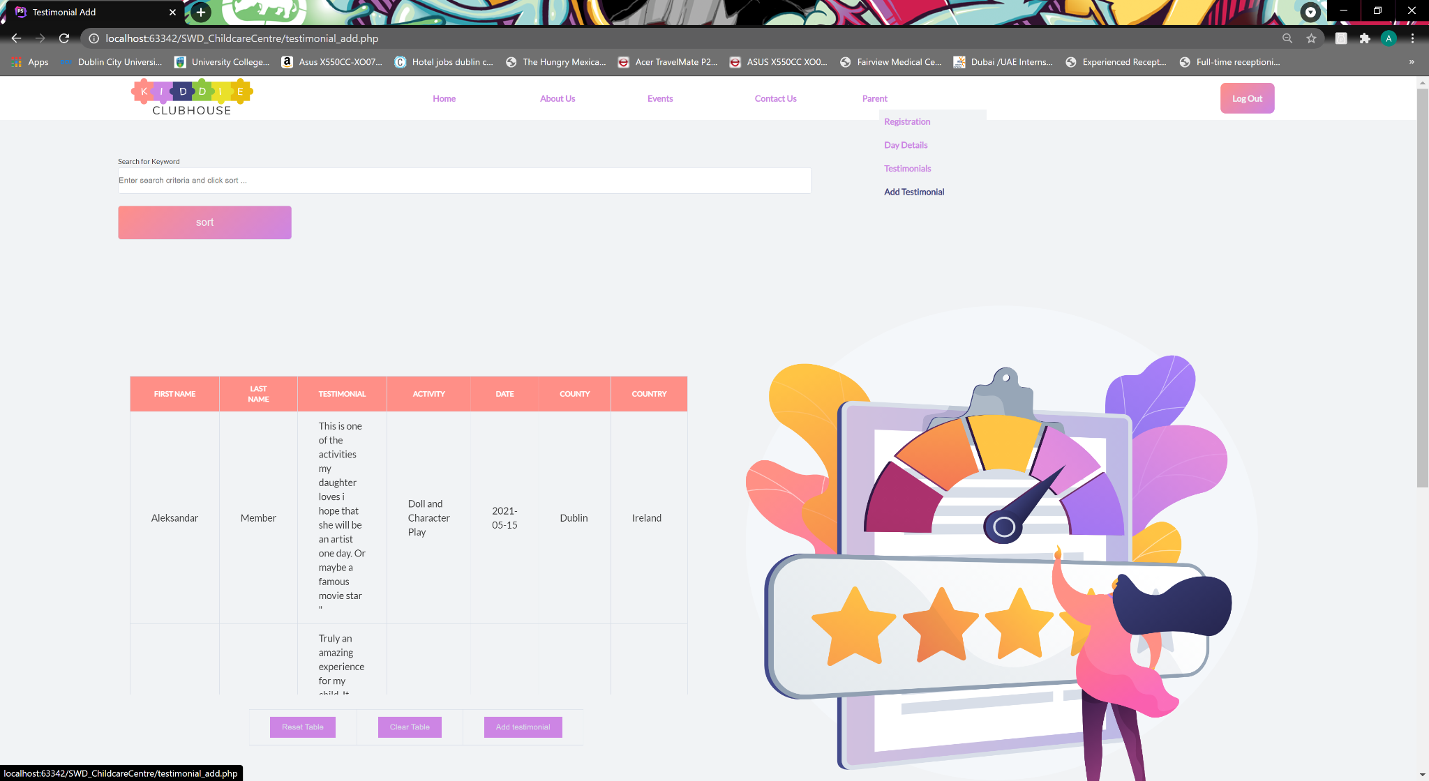
Private Section
Private section for parents
A can view their parent can view a childs
daily activitiy/records.
Filter by date

Slide 5
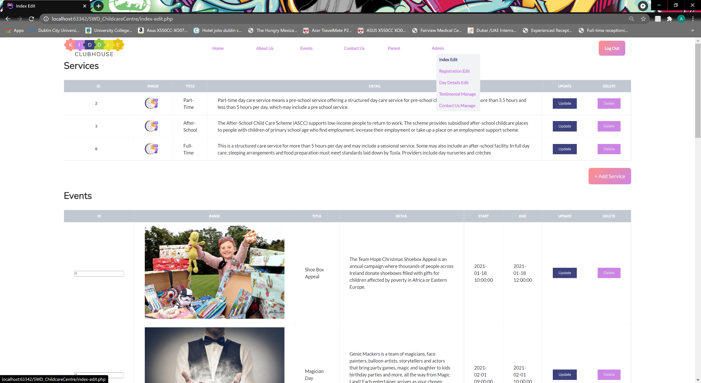
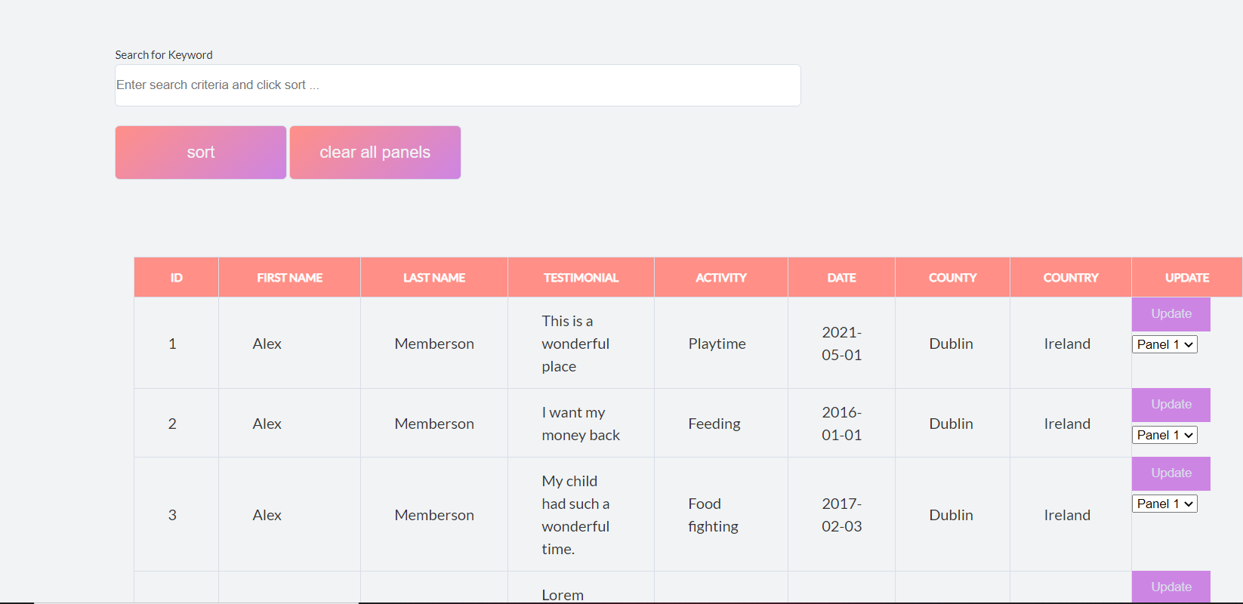
Private Section
Admin backend
Add/remove/edit services
Add/remove/edit events
Add/remove/edit special offers
These changes are reflected on relevant
pages(index, services, etc...)
Edit and update/remove testimonials.
Search by keyword

Slide 6
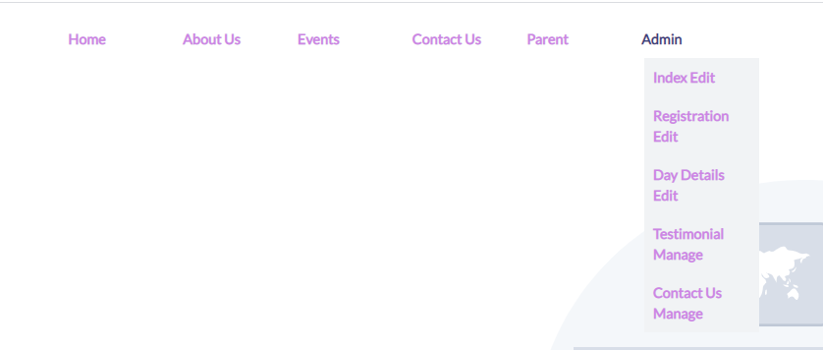
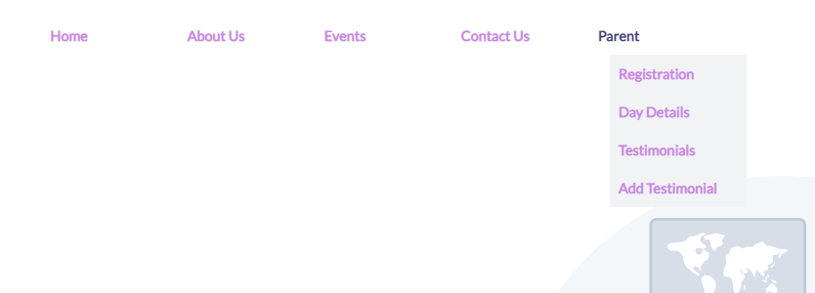
Member/Admin
Only one header file used for entire site.
Navigation built from menu table.
Links are dynamically created.
Extra links in parent section after login
New admin tab for admin login.

Slide 7
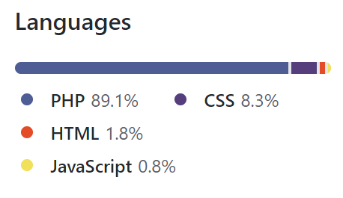
Technologies Used
HTML
CSS
PHP
MySQL
JavaScript
AOS Library (https://michalsnik.github.io/aos/)

Slide 8
Extra Feature(s)
Hosted website unfortunately due to a host session bug occurring online only the public website part is available at the moment - https://meetalex.org/swd/index.html
Remote live database

Slide 9
What is missing?
Email for registration is incomplete(php added but no email server).

Slide 10
Features to Improve
Responsive design
More visually pleasing navigation
Visual Designs to be not as repetitive
Fix the live website bug and bring all functionality online

